Slide 1
Lecture 4
Multiple Regression Analysis
Regression Models and Matrix Notation
The Gauss-Markov Theorem
OLS Estimation
Hypothesis Testing
Goodness of Fit

Slide 2
Multiple Regression Analysis
1.Definition: To explicitly control for many other factors that simultaneously affect the dependent variables.
y = β₀ + β₁x₁ + β₂x₂ + . . . β_{k}x_{k} + u
2. Motivation: Examples

Slide 3

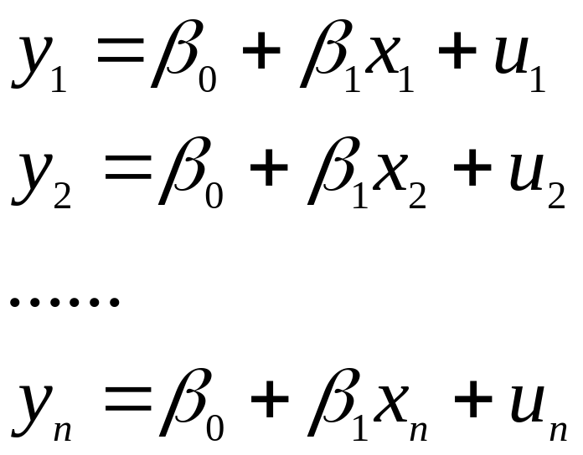
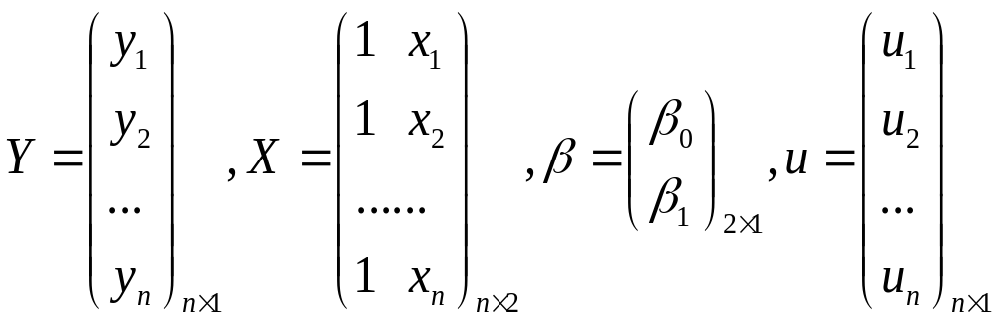
Regression Models and Matrix Notation
The regression model:
It means:

Slide 4
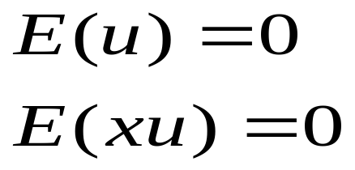
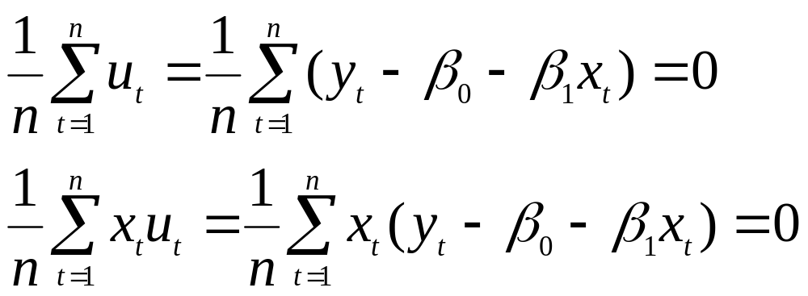
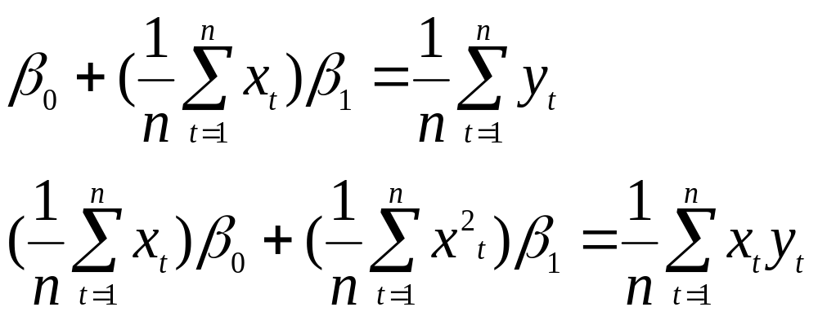
Then from the two assumptions:
We get:

Slide 5
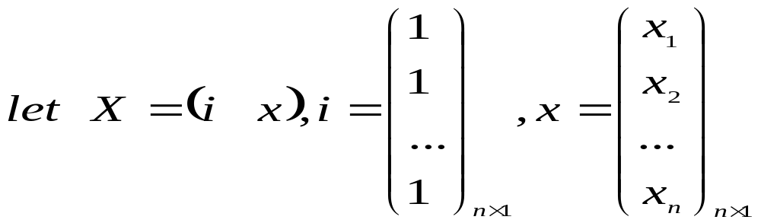
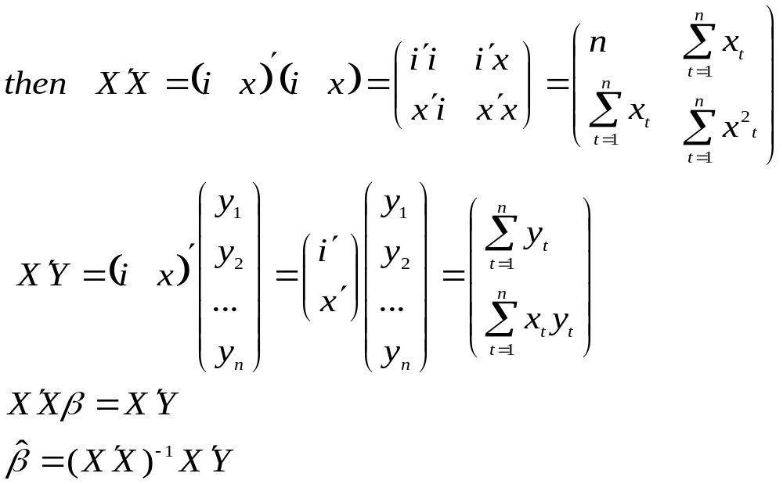

Slide 6
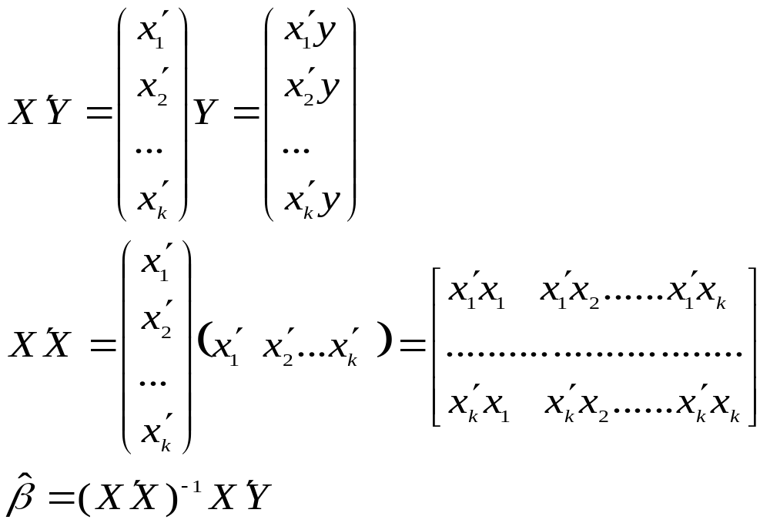
For the multiple linear regression model:

Slide 7
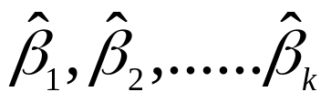

The Gauss-Markov Theorem
(Classical Linear Model)CLM Assumptions:
MLR.1:Linear in parameters
MLR.2:Random Sampling(Exogenously generated data)
MLR.3:Zero Conditional Mean(Exogeneity of the independent variables)
MLR.4:No perfect collinearity(Fulll Rank of X)
MLR.5:Homoskedasticiy and nonautocorrelation
Under above 5 assumptions, are the best linear unbiased estimators (BLUE) of , respectively

Slide 8

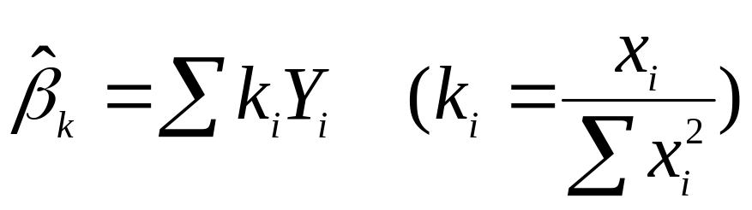
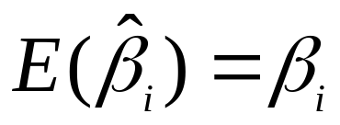
Why is BLUE?
Best Estimators: for any
Linear Estimators: the estimator is the linear function of Y. i.e.
Unbiased Estimators

Slide 9
Assumptions of the Classical Linear Model (CLM)
So far, we know that given the Gauss-Markov assumptions, OLS is BLUE,
In order to do classical hypothesis testing, we need to add another assumption (beyond the Gauss-Markov assumptions)
Assume that u is independent of x₁, x₂,…, x_{k} and u is normally distributed with zero mean and variance s²: u ~ Normal(0,s²)
MLR.6:Normal distribution: the error term are normally distributed

Slide 10
CLM Assumptions (cont)
Under CLM, OLS is not only BLUE, but is the minimum variance unbiased estimator
We can summarize the population assumptions of CLM as follows
y|x ~ Normal(b₀ + b₁x₁ +…+ b_{k}x_{k}, s²)
While for now we just assume normality, clear that sometimes not the case
Large samples will let us drop normality

Slide 11
The homoskedastic normal distribution with
a single explanatory variable
y
f(y|x)
.
.
E(y|x) = β₀ + β₁x
Normal
distributions
x₁
x₂

Slide 12
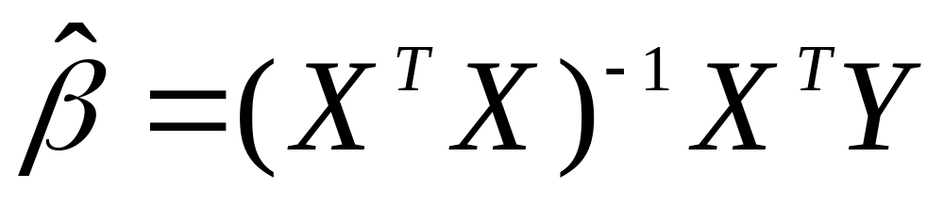
Estimation of Multiple Linear Regression Model
Using the Method of Moments, in our previous class, we have got the OLS estimated coefficient matrix is:
Examples

Slide 13
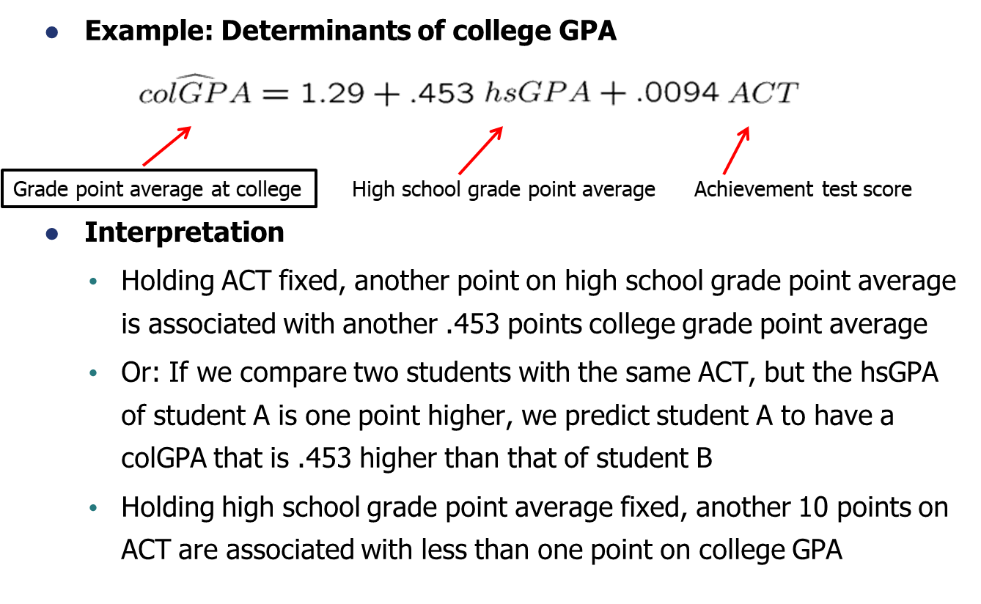

Slide 14
Hypothesis Testing for OLS Estimator
1) Single Restriction
2) Multiple Restriction

Slide 15
Statistical inference in the regression model
  Hypothesis tests about population parameters
  Construction of confidence intervals
Sampling distributions of the OLS estimators
  The OLS estimators are random variables
  We already know their expected values and their variances
  However, for hypothesis tests we need to know their distribution
  In order to derive their distribution we need additional assumptions
  Assumption about distribution of errors: normal distribution

Slide 16
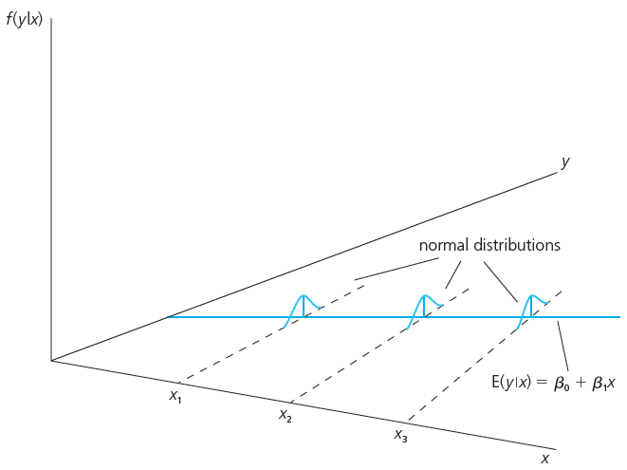
Assumption MLR.6 (Normality of error terms)
It is assumed that the unobserved
factors are normally distributed around the population regression function.
The form and the variance of the distribution does not depend on
any of the explanatory variables.
It follows that:

Slide 17
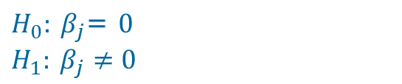


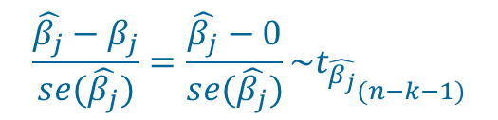
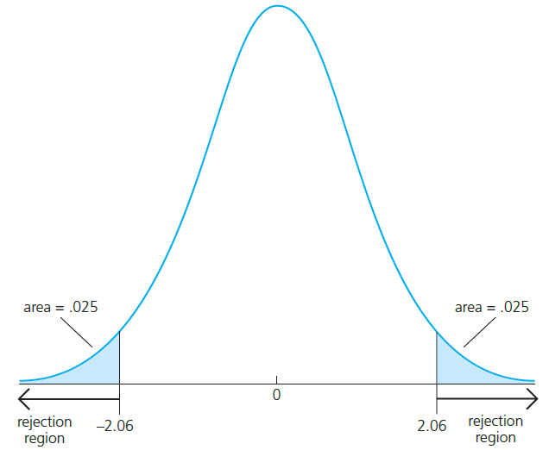
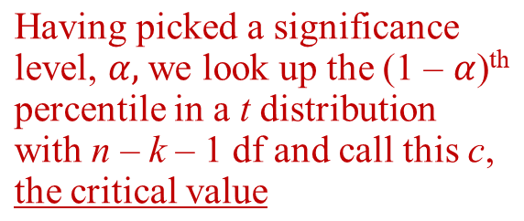
Normal Sampling Distributions
y_{i} = β₀ + β₁X_{i1} + … + β_{k}X_{ik} + u_{i}

Slide 18
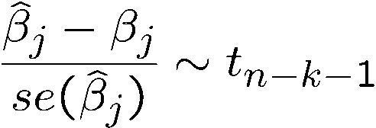

Testing hypotheses about a single population parameter
Theorem 4.2 (t-distribution for the standardized estimators)
Null hypothesis (for more general hypotheses, see below)
Note: The t-distribution is close to the standard normal distribution if n-k-1 is large.

Slide 19
What is degree of freedom(df)?
Since there are k+1 parameters in a regression model with k independent variables and a intercept, we can write:
df=n-(k+1)
=(#of observations)-(#of estimated parameters)
This means: given n-(k+1) of residuals, the remaining k+1 residuals are unknown, i.e. there are only n-(k+1) degrees of freedom.

Slide 20
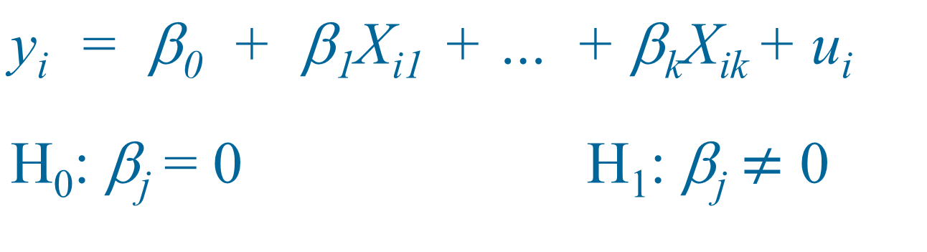
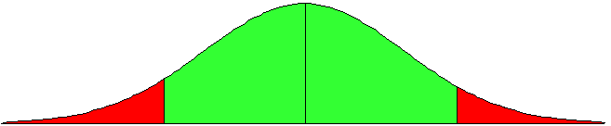
Two-Sided Alternatives
fail to reject
reject
reject
α/2
(1 − α)
α/2
-c
0
c

Slide 21
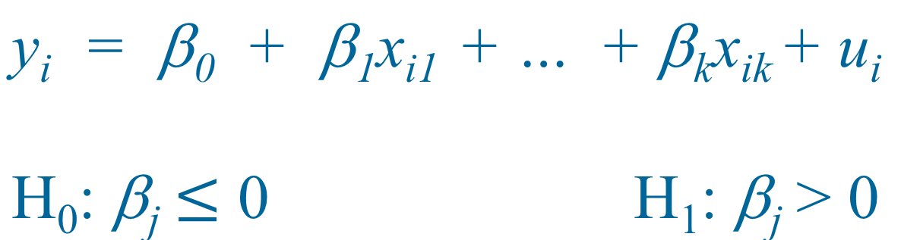
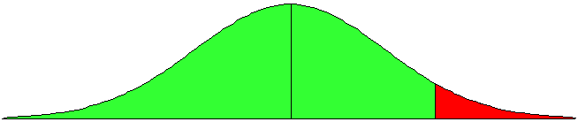
One-Sided Alternatives (cont)
Fail to reject
reject
(1 − α)
α
0
c

Slide 22
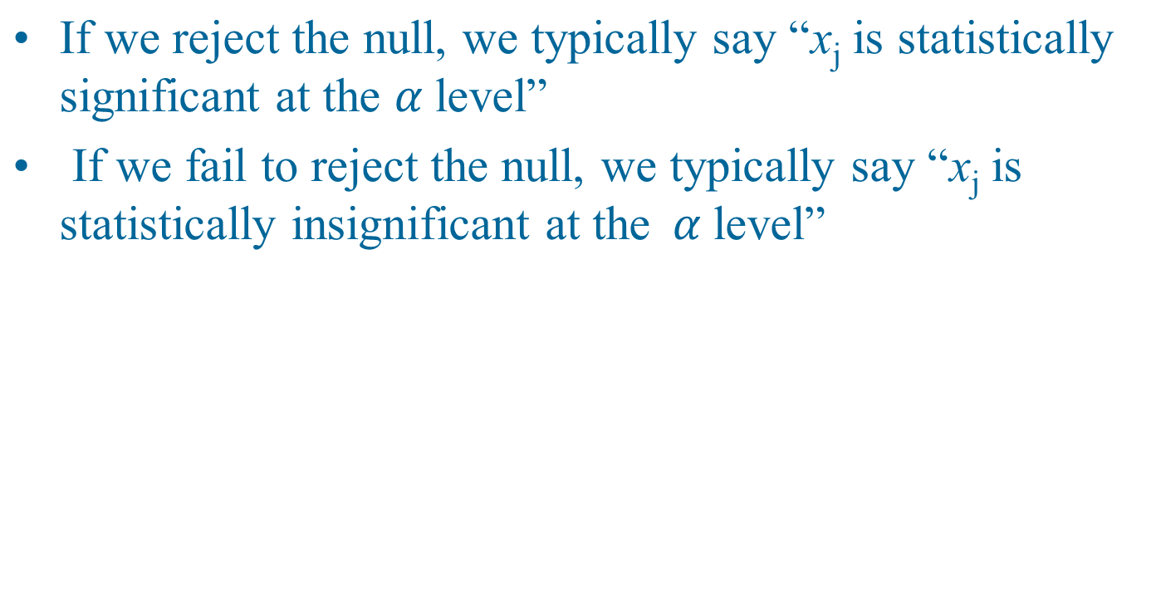
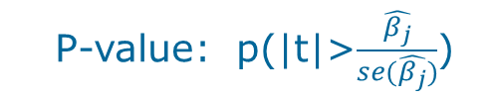
Summary for H₀: β_{j} = 0
P-value<0.10 *
P-value<0.05 **
P-value<0.01 ***

Slide 23
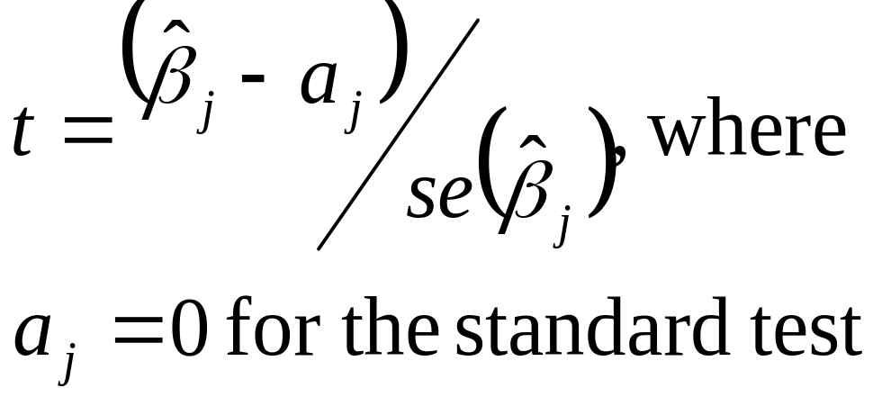
Testing other hypotheses
A more general form of the t statistic recognizes that we may want to test something like H₀: b_{j} = a_{j}
In this case, the appropriate t statistic is

Slide 24
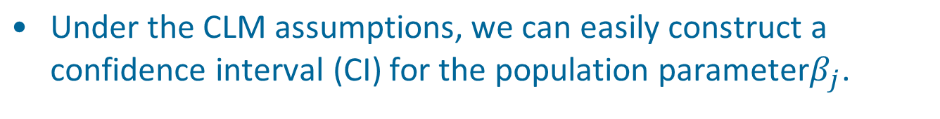

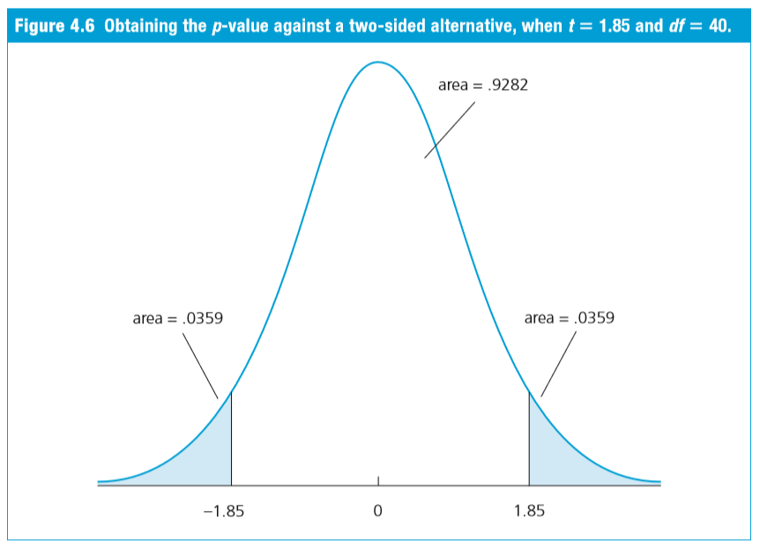
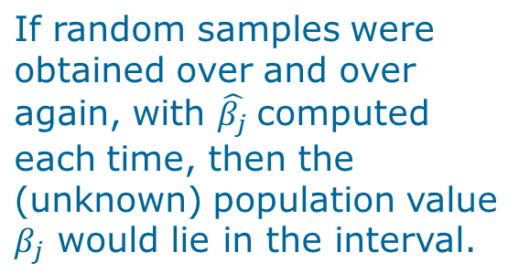
Confidence Intervals

Slide 25
Example:
Testing a Linear Combination
Suppose you are interested in the effect of campaign expenditures on outcomes
Model is
voteA = b₀ + b₁log(expendA) + b₂log(expendB) + b₃prtystrA + u
H₀: b₁ = - b₂, or H₀: q₁ = b₁ + b₂ = 0
b₁ = q₁ – b₂, so substitute in and rearrange ⇒
voteA = b₀ + q₁log(expendA) + b₂₍log(expendB )- log(expendA) )+ b₃prtystrA + u

Slide 26
Example (cont):
This is the same model as originally, but now you get a standard error for b₁ – b₂ = q₁ directly from the basic regression
Any linear combination of parameters could be tested in a similar manner
Other examples of hypotheses about a single linear combination of parameters:
  b₁ = 1 + b₂ ; b₁ = 5b₂ ; b₁ = -1/2b₂ ; etc

Slide 27
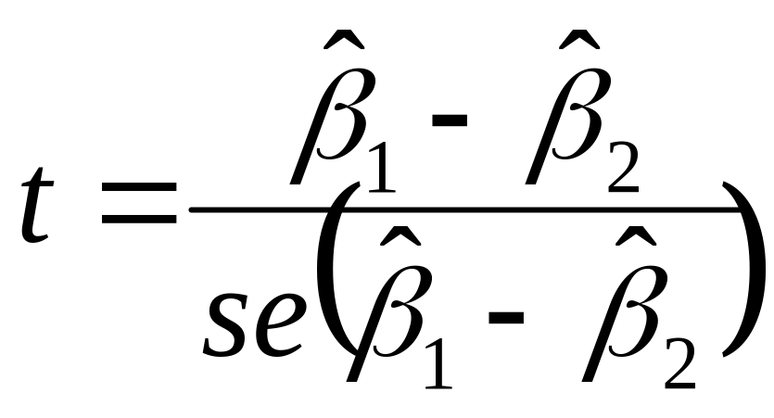
Testing a Linear Combination
Suppose instead of testing whether b₁ is equal to a constant, you want to test if it is equal to another parameter, that is H₀ : b₁ = b₂
Use same basic procedure for forming a t statistic

Slide 28
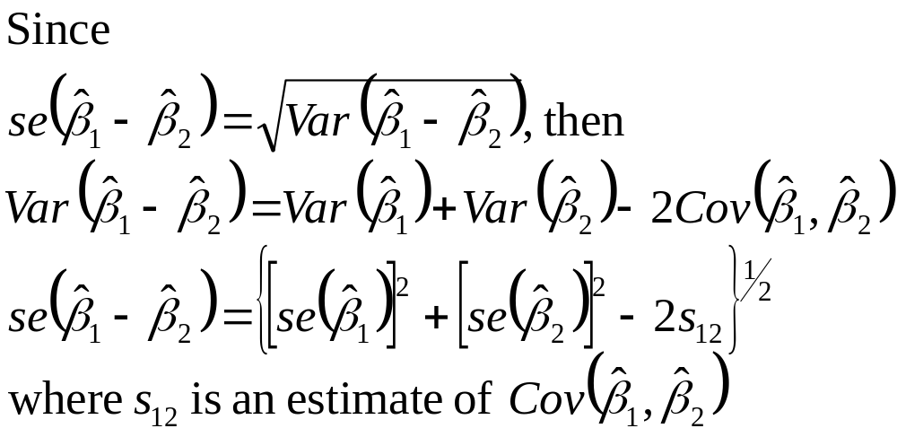
Testing Linear Combi (cont)

Slide 29
Testing a Linear Combi (cont)
So, to use formula, need s₁₂, which standard output does not have
Many packages will have an option to get it, or will just perform the test for you
In Stata, after reg y x1 x2 … xk you would type
test x1 = x2 to get a p-value for the test

Slide 30
Multiple Linear Restrictions
Everything we’ve done so far has involved testing a single linear restriction, (e.g. b₁ = 0 or b₁ = b₂ )
However, we may want to jointly test multiple hypotheses about our parameters
A typical example is testing “exclusion restrictions” – we want to know if a group of parameters are all equal to zero

Slide 31
Testing Exclusion Restrictions
Now the null hypothesis might be something like
H₀: b_{k-q+1} = 0, ... , b_{k} = 0
The alternative is just H₁: H₀ is not true
Can’t just check each t statistic separately, because we want to know if the q parameters are jointly significant at a given level – it is possible for none to be individually significant at that level

Slide 32
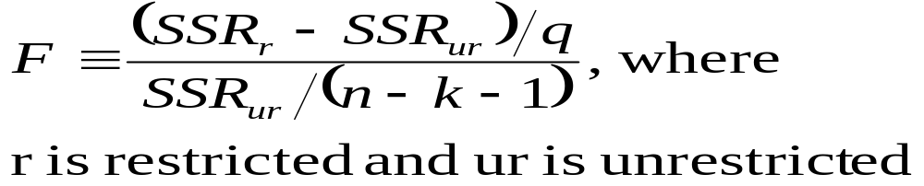
Exclusion Restrictions (cont)
To do the test we need to estimate the “restricted model” without x_{k-q+1},, …, x_{k} included, as well as the “unrestricted model” with all x’s included
Intuitively, we want to know if the change in SSR is big enough to warrant inclusion of x_{k-q+1},, …, x_{k}

Slide 33
The F statistic
The F statistic is always positive, since the SSR from the restricted model can’t be less than the SSR from the unrestricted
Essentially the F statistic is measuring the relative increase in SSR when moving from the unrestricted to restricted model
q = number of restrictions, or df_{r} – df_{ur}
n – k – 1 = df_{ur}

Slide 34
The F statistic (cont)
To decide if the increase in SSR when we move to a restricted model is “big enough” to reject the exclusions, we need to know about the sampling distribution of our F stat
Not surprisingly, F ~ F_{q,n-k-1}, where q is referred to as the numerator degrees of freedom and n – k – 1 as the denominator degrees of freedom

Slide 35
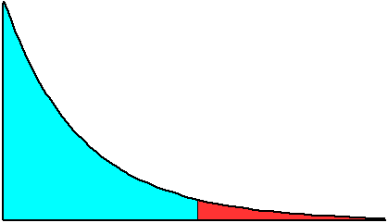
The F statistic (cont)
f(F)
Reject H₀ at α
significance level
if F > c
fail to reject
reject
(1 − α)
α
0
c
F

Slide 36
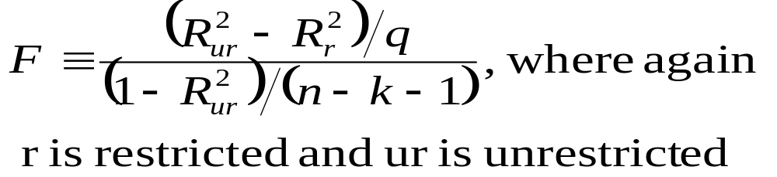
The R² form of the F statistic
Because the SSR’s may be large and unwieldy, an alternative form of the formula is useful
We use the fact that SSR = SST(1 – R²) for any regression, so can substitute in for SSR_{u} and SSR_{ur}

Slide 37
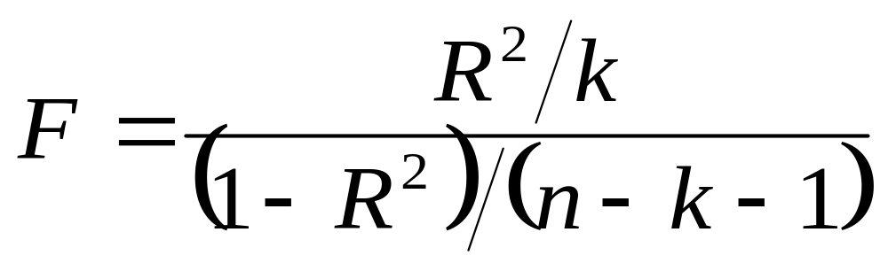
Overall Significance
A special case of exclusion restrictions is to test
H₀: b₁ = b₂ =…= b_{k} = 0
Since the R² from a model with only an intercept will be zero, the F statistic is simply

Slide 38
General Linear Restrictions
The basic form of the F statistic will work for any set of linear restrictions
First estimate the unrestricted model and then estimate the restricted model
In each case, make note of the SSR
Imposing the restrictions can be tricky – will likely have to redefine variables again

Slide 39
Example:
Use same voting model as before
Model is
voteA = b₀ + b₁log(expendA) + b₂log(expendB) + b₃prtystrA + u
now null is H₀: b₁ = 1, b₃ = 0
Substituting in the restrictions:
voteA = b₀ + log(expendA) + b₂log(expendB) + u, so
Use voteA - log(expendA) = b₀ + b₂log(expendB) + u as restricted model

Slide 40
General Linear Restrictions
The basic form of the F statistic will work for any set of linear restrictions
First estimate the unrestricted model and then estimate the restricted model
In each case, make note of the SSR
Imposing the restrictions can be tricky – will likely have to redefine variables again

Slide 41
Example:
Use same voting model as before
Model is
voteA = b₀ + b₁log(expendA) + b₂log(expendB) + b₃prtystrA + u
now null is H₀: b₁ = 1, b₃ = 0
Substituting in the restrictions:
voteA = b₀ + log(expendA) + b₂log(expendB) + u, so
Use voteA - log(expendA) = b₀ + b₂log(expendB) + u as restricted model

Slide 42
F Statistic Summary
Just as with t statistics, p-values can be calculated by looking up the percentile in the appropriate F distribution
Stata will do this by entering:
display fprob(q, n – k – 1, F),
where the appropriate values of F, q,and n – k – 1 are used
If only one exclusion is being tested, then F = t², and the p-values will be the same

Slide 43
Homework
3.7, 3.9, 3.11
C3.7, C3.9

